Slide 1
Agile Software Engineering

Slide 2
Agile software engineering
Software products must be brought to market quickly so rapid software development and delivery is essential.
Virtually all software products are now developed using an agile approach.
Agile software engineering is to:
delivering functionality quickly
responding to changing product specifications
minimizing development overheads.
A large body of ‘agile methods’ have been developed.
Examples: XP, Scrum, Kanban, feature-driven development (FDD),…
There is no ‘best’ agile method or technique.
It depends on who is using the technique, the development team and the type of product being developed

Slide 3
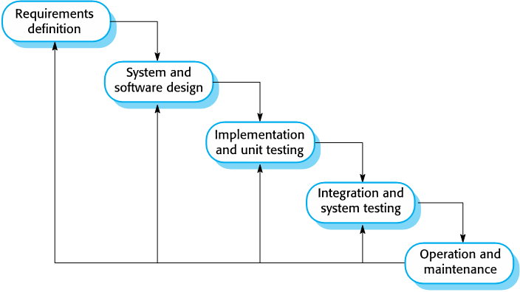
Conventional Software Engineering: Waterfall Methodology!
Plan-driven development was to engineer large, long-lifetime systems
Examples: aircraft control systems, banking, insurance, etc.
These software are often used for several years (decades!).
This approach is based on “sequential” software development processes (aka Waterfall approach) for project planning, requirements specification and analysis and system modelling.
Plan-driven approach involves overheads and documentation and it is not rapid!

Slide 4
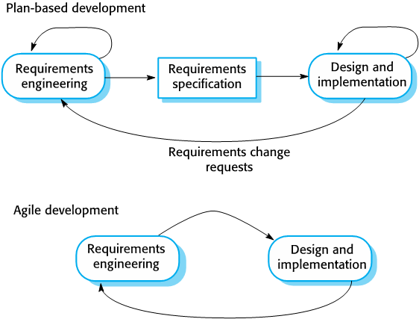
Waterfall vs Agile Methodology
Agile methods were developed in 1990s to address this problem of waterfall methodology.
these methods focus on the software rather than its documentation
develop software in a series of increments
reduce process bureaucracy

Slide 5
The agile manifesto
We are uncovering better ways of developing software by doing it and helping others to do it. Through this work, we have come to value:
- individuals and interactions over processes and tools;
- working software over comprehensive documentation;
- customer collaboration over contract negotiation;
- responding to change over following a plan.
While there is value on the items on the right, we value the items on the left more!

Slide 6
Incremental development
Agile methods have one common theme: incremental development & delivery.
Product development focuses on the software features,
Each feature does something for the software user.
With incremental development, you start by prioritizing the features
The most important features are implemented first.
You only define the details of the feature being implemented in an increment.
That feature is then implemented and delivered.
Users or surrogate users can try it out and provide feedback to the developers
Next, the team will define and implement the next feature of the software

Slide 7
Incremental development

Slide 8
Incremental development activities
Choose features to be included in an increment
From the list of features, select those that can be implemented in next increment
Refine feature descriptions
Add detail to the feature descriptions so that the team have a common understanding of each feature and there is sufficient detail to implement it
Implement and test
Implement the feature and develop automated tests for it to show that its behavior is consistent with its description
Integrate feature and test
Integrate the developed feature with the existing system and test it to check that it works in conjunction with other features
Deliver system increment
Deliver the system increment to product manager for checking and comments. If enough features have been implemented, release a version of the system

Slide 9
Agile development principles
Involve the (surrogate) customer with the development team
Customers provide and prioritize features and evaluate each increment of the system.
Embrace change
Expect the features or their details change as the development team and the product manager learn more about it.
Adapt the software to cope with changes as they are made.
Develop and deliver incrementally
Test and evaluate each increment as it is developed and feed back required changes to the development team.

Slide 10
Agile development principles (2)
Maintain simplicity in software development
Do what you can to eliminate complexity from the system
Focus on people, not things
Trust the development team
Do not expect everyone to do the development in the same way
Team members should be left to develop their own ways of working without being limited by prescriptive software processes.

Slide 11
Extreme programming (XP)
The most influential work that has changed software development culture was the development of XP
The name was coined by Kent Beck in 1998
Nomenclature: practice iterative development to ‘extreme’ levels
XP focused on 12 new development techniques for rapid, incremental software development, change, and delivery
Some of these techniques are now widely used; others are less popular

Slide 12
Extreme programming (XP) practices

Slide 13
Widely adopted XP practices
Incremental planning/user stories
There is no ‘grand plan’ for the system. Instead, what needs to be implemented (the requirements) in each increment are established in discussions with a customer representative.
The requirements are written as user stories. The stories to be included in a release are determined by the time available and their relative priority.
Small releases
The minimal useful set of functionality that provides business value is developed first.
Releases of the system are frequent and incrementally add functionality to the previous release.
Test-driven development (TDD)
Instead of writing code then test it, developers write the tests first!
This helps clarify what the code should actually do
There is always a ‘tested’ version of the code available.
An automated unit test framework is used to run the tests after every change. New code should not ‘break’ the existing code implemented.

Slide 14
Widely adopted XP practices
Continuous integration
As soon as the work on a task is complete, it is integrated into the whole system and a new version of the system is created.
All unit tests from all developers are run automatically and must be successful before the new version of the system is accepted.
Refactoring
Refactoring means improving the structure, readability, efficiency and security of a program.
All developers are expected to refactor the code as soon as potential code improvements are found.
This keeps the code simple and maintainable.

Slide 15
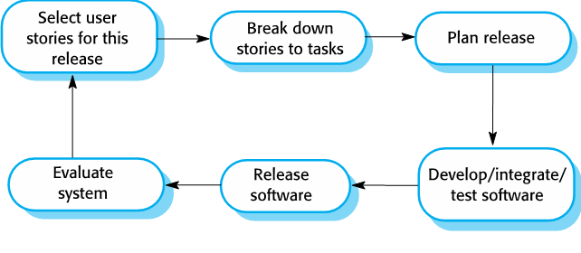
XP release cycle

Slide 16
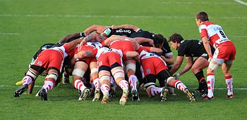
Scrum Agile Software Engineering Methodology
Software companies need to know the cost and development time of a s/w
Plan-driven (waterfall) predict time & cost through long-term development plans.
Plans always change! anything apart from short-term plans are unreliable.
Scrum method provides a framework for agile project organization and planning.
Scrum DOES NOT mandate any specific technical practices.
Scrum vs XP: Scrum focuses on project management and teamwork, whereas XP focuses on code quality and individual programmers' work.

Slide 17
Scrum terminology
Product The software product that is being developed by the Scrum team.
Product owner A team member who is responsible for identifying product features and attributes. They review work done and help to test the product.
Product backlog A to-do list of items such as bugs, features and product improvements that the Scrum team have not yet completed.
Development team A small self-organizing team of five to eight people who are responsible for developing the product.
Sprint A short period, typically two to four weeks, when a product increment is developed.

Slide 18
Scrum terminology
Scrum meeting A daily team meeting where progress is reviewed and work to be done that day as discussed and agreed.
ScrumMaster A team coach who guides the team in the effective use of Scrum
Potentially shippable product increment The output of a sprint which should be of high enough quality to be deployed for customer use.
Velocity An estimate of how much work a team can do in a single sprint.

Slide 19
Key roles in Scrum
The Product Owner is responsible for ensuring that the development team is always focused on the product they are building rather than diverted into technically interesting but less relevant work.
The product manager normally takes on the Product Owner role.
The ScrumMaster is a Scrum expert whose job is to guide the team in the effective use of the Scrum method.
ScrumMaster is not a conventional project manager, but is a coach for the team. They have authority within the team on how Scrum is used.
In many companies that use Scrum, the ScrumMaster also has some project management responsibilities.

Slide 20
Scrum and sprints
In Scrum, software is developed in sprints
A sprint is a fixed-length period (2 - 4 weeks) in which software features are developed and delivered.
During a sprint, the team has daily meetings (Scrums) to review progress and to update the list of work items that are incomplete
Sprints should produce a ‘shippable product increment’
This means that the developed software should be complete and ready to deploy.

Slide 21
Scrum Cycles

Slide 22
Main benefits of using Scrum

Slide 23
Key Scrum practices
Product backlog This is a to-do list of items to be implemented that is reviewed and updated before each sprint.
Timeboxed sprints Fixed-time (2-4 weeks) periods in which items from the product backlog are implemented,
Self-organizing teams Self-organizing teams make their own decisions and work by discussing issues and making decisions by consensus.

Slide 24
Roles vs Persona in a Software Product
In the previous slide, we mentioned that each user story must explain requirement of a “role” (e.g., teacher, admin, etc.)
Another related concept needed in software products is “persona”:
A persona is a detailed, fictional character that represents a specific user type.
It includes demographic information, behaviors, goals, and pain points.
Personas help teams deeply understand the motivations and needs of users.
A role refers to a specific function or position that a user may have in a system
Roles define what actions a user can take or what permissions they have.
Examples: "administrator," "editor," or "viewer."
Note: a persona might have one or multiple roles, depending on how they interact with the software.
For example, "Budget-Conscious Ahmad" could be a persona who takes on the role of both a "user" and a "reviewer" in the financial app.

Slide 25
Usages of Persona in Software Product Engineering
Example Persona in a finance management software product: "Budget-Conscious Ahmad"
Background:
Age: 28
Occupation: Marketing Coordinator
Tech-savvy but prefers user-friendly interfaces.
Goals:
To track her spending and savings easily.
To create a budget that helps her save for a vacation.
To receive reminders about upcoming bills.
Challenges:
Feels overwhelmed by complex financial apps.
Struggles with keeping track of expenses in real time.
Needs motivation to stick to her budget.
Feature Prioritization: The team decides to prioritize a simple budgeting tool and user-friendly interface based on Ahmad’s needs.
Design Decisions: User flows are designed to minimize the number of steps Ahmad has to take to input his expenses, keeping in mind his preference for simplicity.
Testing: During user testing, the team invites participants who match Ahmad’s demographics to ensure the app resonates with users like him.
Marketing Strategy: Marketing materials highlight features that appeal to budget-conscious young professionals, directly addressing Ahmad’s goals and challenges.

Slide 26
From personas to features
A way of representing users
Natural language descriptions of a user interacting with a software product
Natural language descriptions of something that is needed or wanted by users
Fragments of product functionality

Slide 27
Product backlogs (user stories)
The product backlog is a list of what needs to be done to complete the development of the product.
The items on this list are called product backlog items (PBIs).
The product backlog may include a variety of different items
product features to be implemented
user requests
essential development activities
desirable engineering improvements
The product backlog must be prioritized, so that the items that be implemented first are at the top of the list.

Slide 28
How to Write Backlogs: User Stories (Features)+Spikes
General format of user stories: As a ...., I want to ….., so that…..
First blank is filled with the role. Example: buyer, seller, platform (amazon) owner
Second blank is filled with the goal
The third blank is filled with a reason
User stories must be:
non-technical and from the user perspective
independent (from other stories) and self-sufficient
Valuable (meaningful) stories: add a value to the project
negotiable (i.e., can be changed at any time upon need)
estimable- must be descriptive and small, so we can estimate the work for it.
User stories must be small and testable
Each user story must have one or more acceptance criteria
Write one or more sentences as minimum requirements to check this story done
Spikes: items in the backlog that are NOT user-facing.
Ex: setting up a development environment, setup servers and databases, etc.
These are NOT user stories!

Slide 29
Examples of product backlog (user story + spike)
1. As a teacher, I want to be able to configure the tools that are available to individual classes (feature) #Estimation of efforts… #Acceptance criteria….
2. As a parent, I want to be able to view my child's work and assessments made by their teachers. (feature) #Estimation of efforts… #Acceptance criteria: the parent can see all exams’ final grades and click to see its breakdown
3. As a teacher of young children, I want a pictorial interface for children with limited reading ability. (user request)
4. Establish criteria for the assessment of open-source software as a basis for parts of this system. (development activity) → spike
5. Refactor user interface code to improve understandability and performance. (engineering improvement) → spike
6. Implement encryption for all personal user data. (engineering improvement) → spike

Slide 30
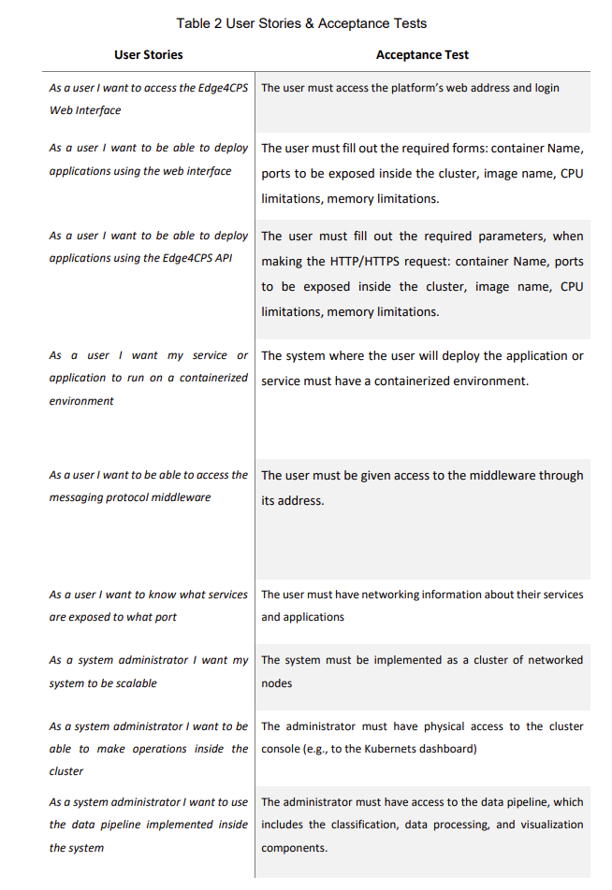
Example: Acceptance Testing
Edge4CPS system: developing distributed and scalable CPSs that efficiently handle large volumes of data while ensuring high performance and reliability
Source: https://arxiv.org/pdf/2407.14529

Slide 31
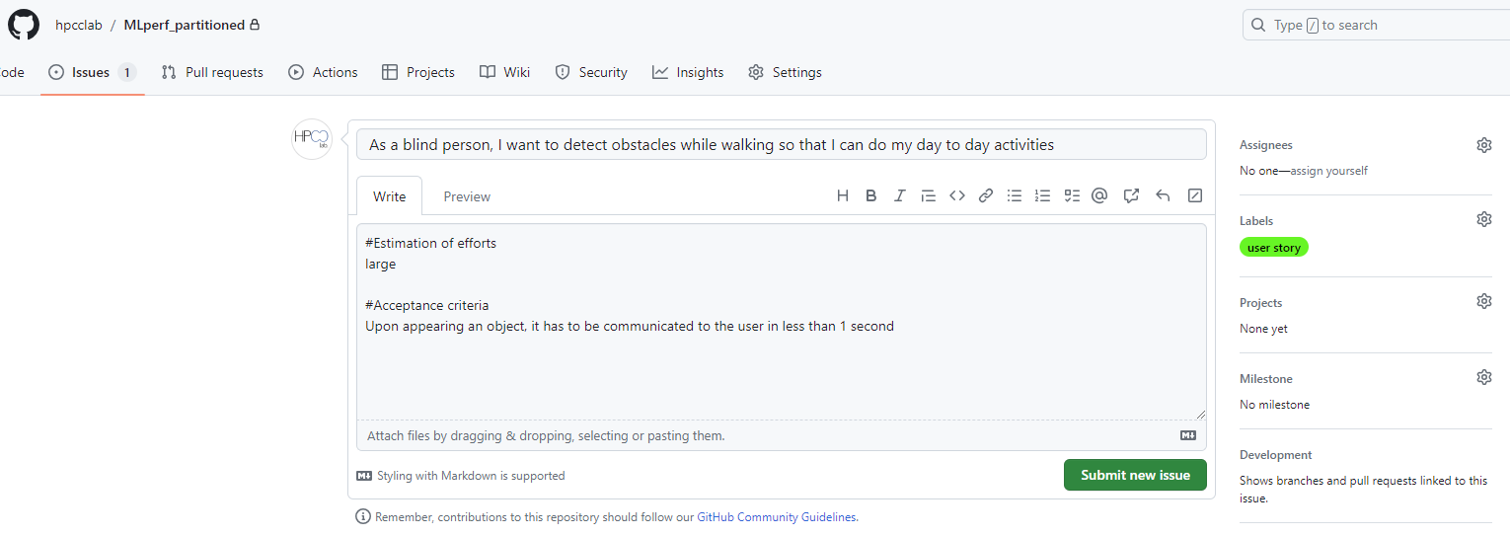
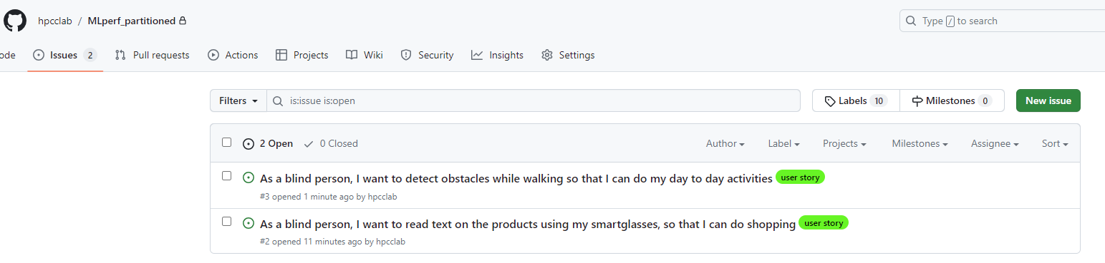
Defining User Stories in Github
User story
Extra details
List of all issues (user stories)

Slide 32
Product backlog item states
Ready for consideration These are high-level ideas and feature descriptions that will be considered for inclusion in the product. They are tentative so may radically change or may not be included in the final product.
Ready for refinement
The team has agreed that this is an important item that should be implemented as part of the current development.
There is a reasonably clear definition of what is required. However, work is needed to understand and refine the item.
Ready for implementation
The PBI has enough detail for the team to estimate the effort involved and to implement the item. Dependencies on other items have been identified.

Slide 33
Product backlog activities
Refinement Existing PBIs are analyzed and refined to create more detailed PBIs. This may lead to the creation of new product backlog items.
Estimation The team estimate the amount of work required to implement a PBI and add this assessment to each analyzed PBI.
Creation New items are added to the backlog. These may be new features suggested by the product manager, required feature changes, engineering improvements, or process activities such as the assessment of development tools that might be used.
Prioritization The product backlog items are reordered to take new information and changed circumstances into account.

Slide 34
Product backlog activities

Slide 35
PBI estimation metrics
Effort required
This may be expressed in person-hours or person-days, i.e. the number of hours or days it would take one person to implement that PBI.
This is NOT the same as calendar time. Several people may work on an item, which may shorten the calendar time required.
Ex: if a PBI requires 5 person-hours, it means 1 person will do it in 5 hours. However, if we have 5 persons in our team, the work will be done in 1 hour
Story points
Story points are an arbitrary estimate of the effort involved in implementing a PBI, taking into account the size of the task, its complexity, the technology that may be required and the ‘unknown’ characteristics of the work.
Story points are estimated relatively. The team agrees on the story points for a baseline task and other tasks are estimated by comparison with this e.g. more/less complex, larger/smaller etc.

Slide 36
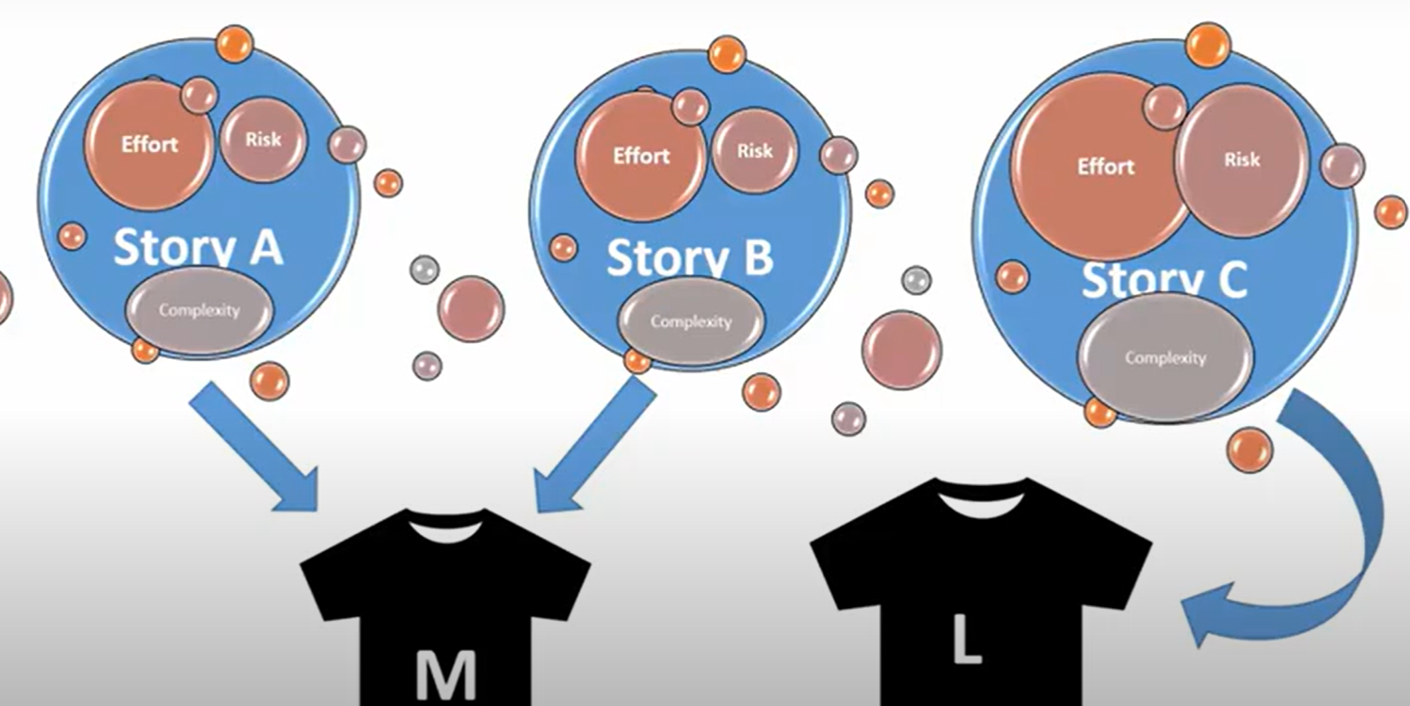
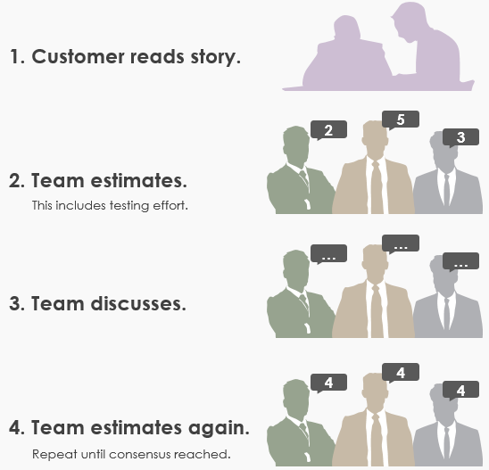
How to estimate the work a user story takes?
Amazon approach: T-shirt sizing (small, medium, large, xlarge,…)
Poker planner:
use cards based on Fibonacci sequence across the team
read the user story and ask everyone to show cards at the same time
ask outliers to explain their position.
do this until the team reaches a consensus

Slide 37
Timeboxed sprints
Products are developed in a series of sprints, each of which delivers an increment of the product or supporting software.
Sprints are short duration activities (2-4 weeks or sometimes up to 6 weeks) and take place between a defined start and end date.
Sprints are timeboxed, which means that development stops at the end of a sprint whether or not the work has been completed.
During a sprint, the team works on the tasks of the certain backlog items.

Slide 38
Benefits of using timeboxed sprints

Slide 39
Sprint activities
Sprint planning
Work items to be completed in that sprint are selected and refined to create a sprint backlog.
This should not last more than a day at the beginning of the sprint.
Sprint execution
The team works to implement the sprint backlog items that have been chosen for that sprint.
If it is impossible to complete all the sprint backlog items, the sprint is NOT extended.
Unfinished items are returned to the product backlog & queued for a future sprint.
Sprint reviewing
The work done in the sprint reviewed by the team and external stakeholders.
The team reflects on what went well and what went wrong during the sprint with a view to improving their work process.

Slide 40
Sprint activities

Slide 41
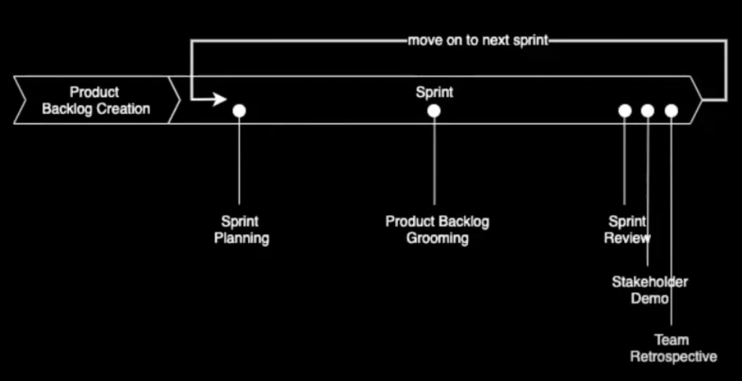
Sprint Timeline

Slide 42
Sprint planning
Establish an agreed "sprint goal"
Sprint goals may be focused on software functionality, support or performance and reliability.
Decide on the list of items from the product backlog that should be implemented
Create a sprint backlog
This is a more detailed version of the product backlog that records the work to be done during the sprint in form of tasks

Slide 43
Sprint goals: types and examples

Slide 44
Sprint planning
In a sprint plan, the team decides which items in the product backlog should be implemented during that sprint
Decisive factors are the effort estimates associated with PBIs and the team’s velocity
The output of the sprint planning process is a sprint backlog
The sprint backlog is a breakdown of a PBI to show what is involved in implementing it during that sprint. → PBI is broken to discrete tasks
A task is generally a unit of work that is doable by one developer in one day
If you think a task takes more than one day → break it to smaller tasks!
Every task must be assigned to a team-member! (no orphan tasks)
Many tools to manage sprint tasks: Github projects, Trello, etc.
During a sprint, the team have daily meetings (scrums) to coordinate their work.

Slide 45
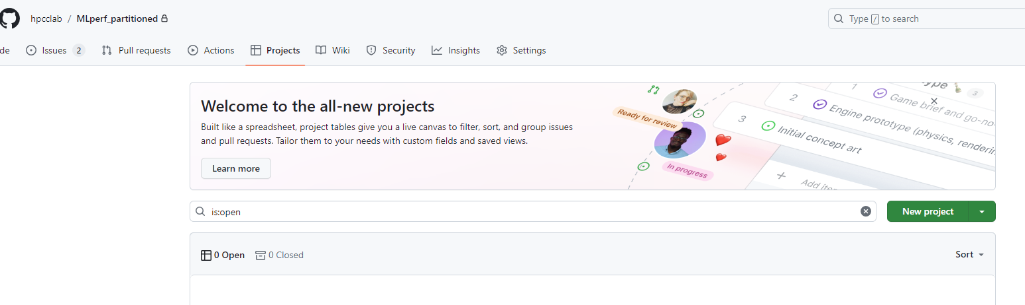
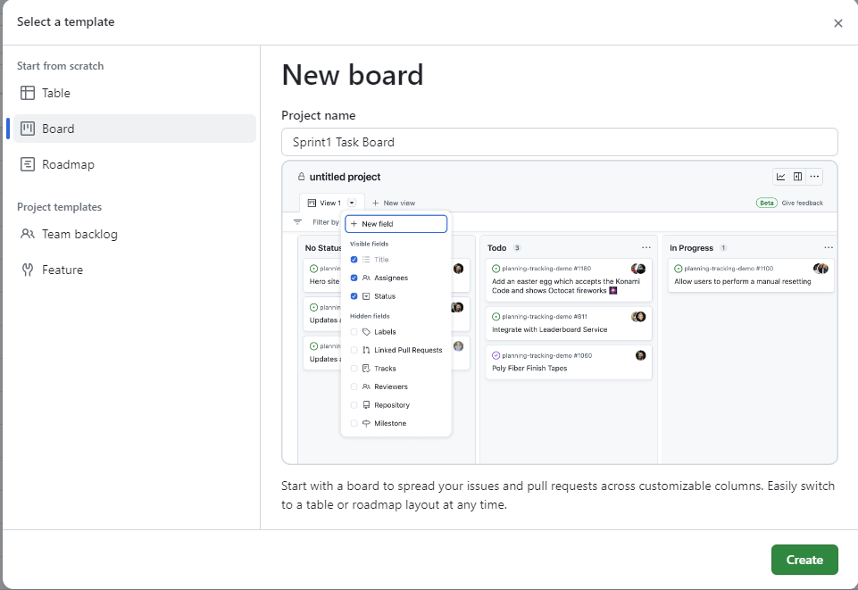
Sprint Tasks in Github

Slide 46
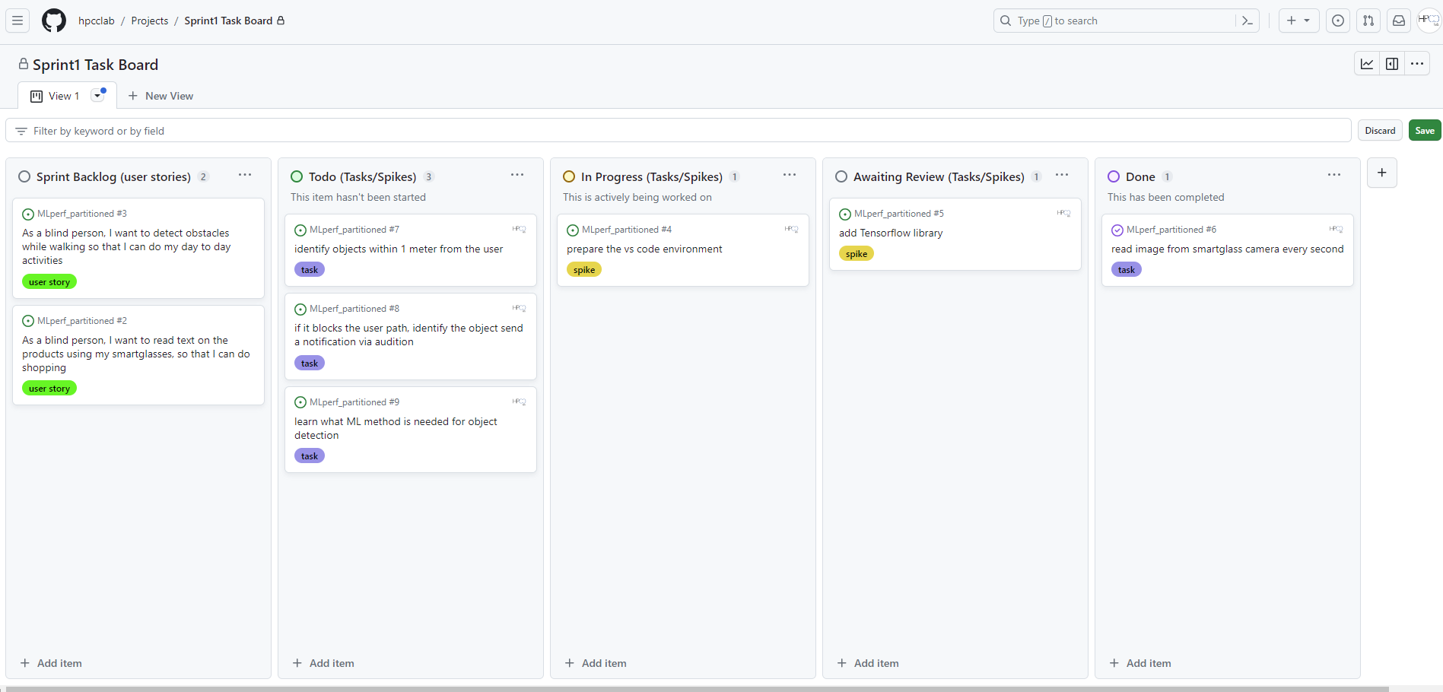
Sprint Tasks in Github

Slide 47
Scrum Meetings
A scrum is a short, daily meeting held at the beginning of the day.
During a scrum meeting:
All team members share information:
progress since the previous day’s scrum
problems that have arisen
plans for the coming day
The sprint backlog is reviewed:
completed items are removed from it;
new items may be added to the backlog as new information emerges.
Deciding who should work on sprint backlog tasks/spikes that day.
Scrum meeting helps everyone on the team knows what is going on and, if problems arise, can re-plan short-term work to cope with them.
Scrum meetings should be short (5 minutes) and focused.
To dissuade team members from getting involved in long discussions, they are sometimes organized as ‘stand-up’ meetings where there are no chairs in the meeting room!

Slide 48
Agile activities
Scrum is not about technical agile activities that should be used
However, two practices that should always be used in a sprint:
Test automation
As far as possible, product testing should be automated.
You should develop a suite of executable tests that can be run at any time.
Continuous integration changes to the software modules should be immediately integrated with other software components to create a system.
the integrated system should then be tested to check for unanticipated component interaction problems.

Slide 49
Code completeness checklist
Reviewed
The code has been reviewed by another team member who has checked that it meets agreed coding standards, is understandable, includes appropriate comments, and has been refactored if necessary.
Unit tested
All unit tests have been run automatically and all tests have executed successfully.
Integrated The code has been integrated with the project codebase and no integration errors have been reported.
Integration tested
All integration tests have been run automatically and all tests have executed successfully.
Accepted
Acceptance tests have been run if appropriate and the product owner or the development team have confirmed that the product backlog item has been completed.

Slide 50
Sprint Review Meeting
At the end of each sprint, there is a review meeting, which involves the whole team. This meeting:
reviews whether the sprint has met its goal.
sets out any new problems and issues that have emerged during the sprint.
is a way for a team to reflect on how they can improve the way they work.
The product owner/manger has the ultimate authority to decide whether the goal of the sprint has been achieved!
They should confirm that the implementation of the selected product backlog items is complete.

Slide 51
Self-organizing teams

Slide 52
Team size and composition
Scrum team size is between 5 and 8 people with different experiences
Teams have to tackle diverse tasks and so usually require people with different skills, such as networking, user experience, database design and so on.
A team of 5-8 people is large enough to be diverse yet small enough to communicate informally and effectively and to agree on the team priorities
The advantage of a self-organizing team is that it can be a cohesive team that can adapt to change.
Because the team (rather than individuals) take responsibility for the work, they can cope with people leaving and joining the team.
Good team communication means that team members inevitably learn something about each other’s areas

Slide 53





Example: Team Composition for Full Stack Web Development
Software Engineer
Programming Language
Frameworks
Team Composition
Purpose
Images -> Tool/IDE’s
DB Developer
Backend (API) Developer
UI/UX Developer
Frontend Developer
QA Engineer
Cloud Engineer
SQL Server
.Net Core
Angular (TS/JS)
Java
DevOps
Cloud Admin
Selenium
CI/CD
SSMS
For Orchestration
For Automation Testing
To create and maintain infrastructure like VPN, VM, App Services, SQL, Storage accounts, etc
For Relational Database
For Interacting DB with UI
For UI Designing
For User Interface
For User Interface
Slide credits to Praveen Suggala

Slide 54



















Major Stacks & Frameworks
Backend
API
Programming Language
User Interface
Quality Assurance(QA)
Cloud
Popular stacks

Slide 55
Team coordination
The developers of Scrum assumed that teams would be co-located (in the same room) and could communicate informally.
Daily scrums mean that the team members know what’s been done and what others are doing.
However, the use of daily scrums as a coordination mechanism is based on two assumptions that are not always correct:
Team members may be part-time and may work in different places (remote).
Some team members may work flexible hours (e.g. because of childcare responsibilities) or may work on several projects at the same time.

Slide 56
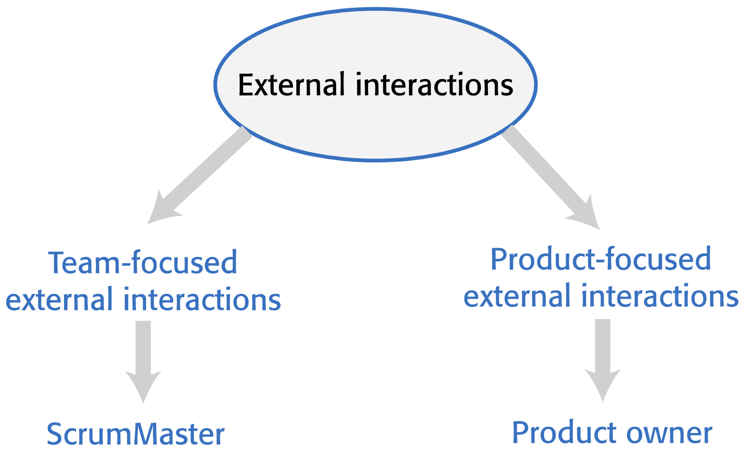
External interactions
External interactions are interactions that team members have with people outside of the team.
In Scrum, developers should focus on development! only the ScrumMaster and Product Owner is involved in external interactions.
The intention is that the team should be able to work on software development without external interference or distractions.

Slide 57
Project management
There is a need for development teams to report on progress to company management.
A self-organizing team has to appoint someone for these responsibilities.
Because of the need to maintain continuity of communication with people outside the group, rotating these activities around team members is not viable.
The developers of Scrum did not envisage that the ScrumMaster should also have project management responsibilities.
In many companies, however, the ScrumMaster has to take on project management responsibilities.
They know the work going on and are in the best position to provide accurate information and project plans and progress.

Slide 58
Project management responsibilities

Slide 59
Key points 1
The best way to develop software products is to use agile software engineering methods that are geared to rapid product development and delivery.
Agile methods are based around iterative development and the minimization of overheads during the development process.
Extreme programming (XP) is an influential agile method that introduced agile development practices such as user stories, test-first development and continuous integration. These are now mainstream software development activities.
Scrum is an agile method that focuses on agile planning and management. Unlike XP, it does not define the engineering practices to be used. The development team may use any technical practices that they believe are appropriate for the product being developed.
In Scrum, work to be done is maintained in a product backlog – a list of work items to be completed. Each increment of the software implements some of the work items from the product backlog.

Slide 60
Key points 2
Sprints are fixed-time activities (usually 2–4 weeks) where a product increment is developed. Increments should be ‘potentially shippable’ i.e. they should not need further work before they are delivered.
A self-organizing team is a development team that organizes the work to be done by discussion and agreement amongst team members.
Scrum practices such as the product backlog, sprints and self-organizing teams can be used in any agile development process, even if other aspects of Scrum are not used.

